Slide 1
Lecture 6
Newton Interpolation

Slide 2
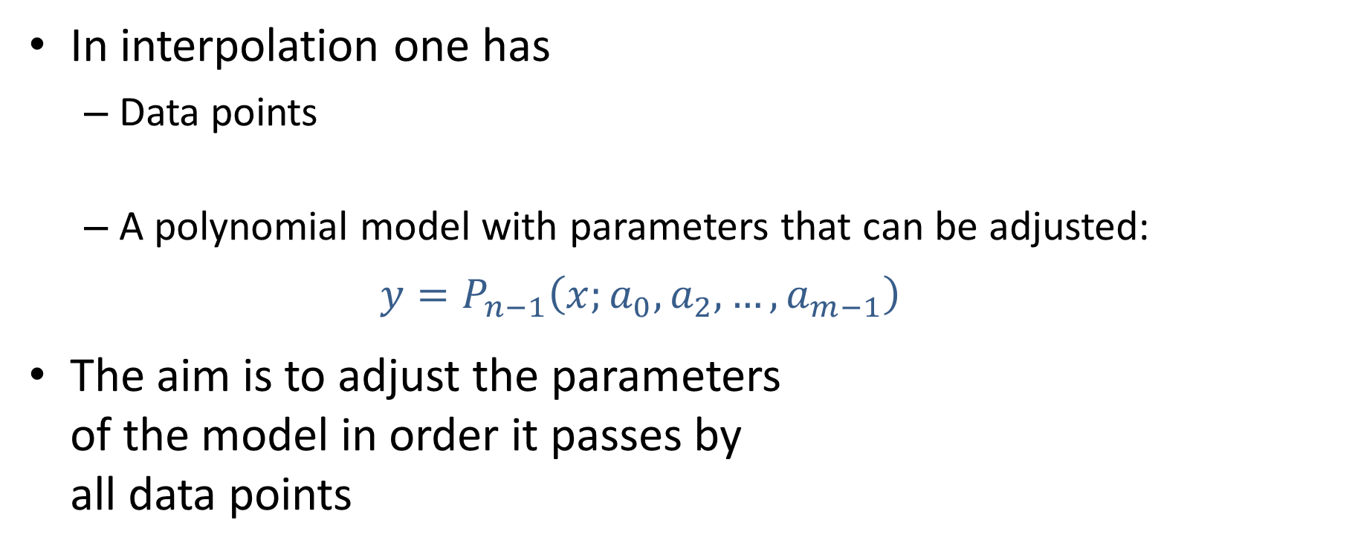


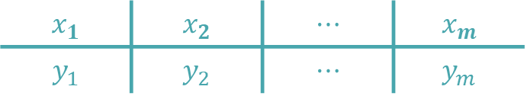
Overview of Newton Interpellation
In interpolation one has
Data points
A polynomial model with parameters that can be adjusted: $y=P_{n−1}\left(x;a_{0},a_{2},…,a_{m−1}\right)$
The aim is to adjust the parameters of the model in order it passes by all data points
$$x_{1}$$ | $$x_{2}$$ | $$⋯$$ | $$x_{m}$$
$$y_{1}$$ | $$y_{2}$$ | $$⋯$$ | $$y_{m}$$
$$y_{i}$$
$$x_{i}$$
Notes:
In this lecture we will discuss a second method to solve polynomial interpolation problems
As always we have a data set and our interpolating polynomial
Our aim is to choose the m parameters of the interpolating polynomial such that it passes exactly by all data points

Slide 3



Newton Interpolation
Model to be adjusted:
$${P_{m−1}(x)=a}_{0}+a_{1}x+a_{2}x^{2}+…+a_{m−1}x^{m−1}$$
The idea of Newton interpolation is to write the polynomial differently in order to get a simpler system of equations to solve
$$P_{m−1}(x)=$$
$$b_{0}$$
$$+b_{1}\left(x−x_{1}\right)$$
$${+b}_{2}\left(x−x_{1}\right)\left(x−x_{2}\right)$$
$${+b}_{3}\left(x−x_{1}\right)\left(x−x_{2}\right)\left(x−x_{3}\right)$$
$$+…$$
$${+b}_{m−1}\left(x−x_{1}\right)…\left(x−x_{m−1}\right)$$
Notes:
In the previous method we used the traditional form for writing down the interpolating polynomial
In this alternate method, called Newton interpolation, we will write the interpolating polynomial differently
We write is as
$P_{m−1}(x)=$ b0
$$+b_{1}\left(x−x_{1}\right)$$
$${+b}_{2}\left(x−x_{1}\right)\left(x−x_{2}\right)$$
And so on until
$$b_{m−1}\left(x−x_{1}\right)…\left(x−x_{m−1}\right)$$
Note that we changed the symbols of the model parameter from ai to bi because they will not have the same values.
But the interpolating polynomial still is of degree n-1 as can be seen from its last monomial and still contains m model parameters.

Slide 4
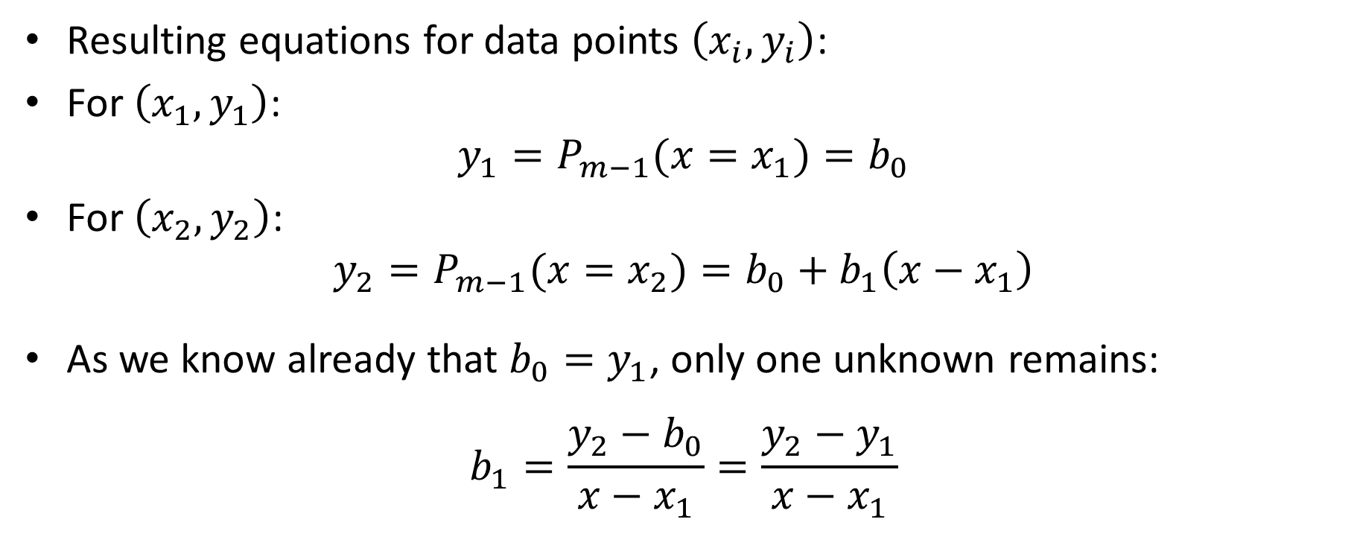
Newton Interpolation
Resulting equations for data points $\left(x_{i},y_{i}\right)$:
For $\left(x_{1},y_{1}\right)$:
$${y_{1}=P}_{m−1}(x=x_{1})=b_{0}$$
For $\left(x_{2},y_{2}\right)$:
$${y_{2}=P}_{m−1}(x=x_{2})=b_{0}+b_{1}\left(x−x_{1}\right)$$
As we know already that $b_{0}=y_{1}$, only one unknown remains:
$$b_{1}=\frac{y_{2}−b_{0}}{x−x_{1}}=\frac{y_{2}−y_{1}}{x−x_{1}}$$
Notes:
Using this alternate form of the interpolating polynomial allows to obtain much simpler equations for the model parameters
Let us force the Interpolating polynomial to pass by all data points
For the first point (x1,y1) this results into the equation y1=b0
We already found the first model parameter.
If we use the second data point we obtain the equation y2=bo+b1(x-x1)
As we already know bo, we only have one unknown left and we can calculate b1 as $b_{1}=\frac{y_{2}−y_{1}}{x−x_{1}}$

Slide 5
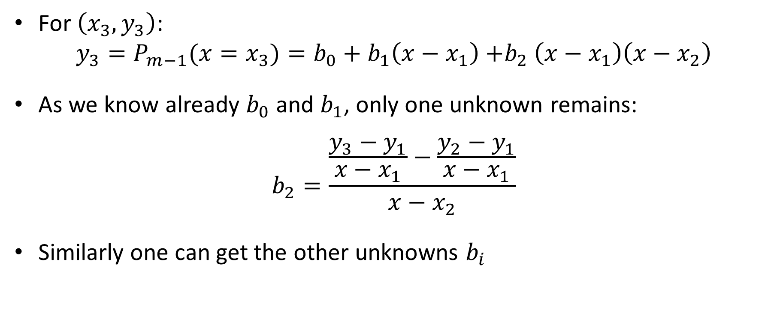
Newton Interpolation
For $\left(x_{3},y_{3}\right)$:
$${y_{3}=P}_{m−1}(x=x_{3})=b_{0}+b_{1}\left(x−x_{1}\right){+b}_{2}\left(x−x_{1}\right)\left(x−x_{2}\right)$$
As we know already $b_{0}$ and $b_{1}$, only one unknown remains:
$$b_{2}=\frac{\frac{y_{3}−y_{1}}{x−x_{1}}−\frac{y_{2}−y_{1}}{x−x_{1}}}{x−x_{2}}$$
Similarly one can get the other unknowns $b_{i}$
Notes:
We can proceed further like this
Using the third point will result in an equation involving the model parameters bo, b1 and b2
But b0 and b1 are already known
Consequently b2 can be computed
In similar way we can proceed with the next data point until the last one

Slide 6
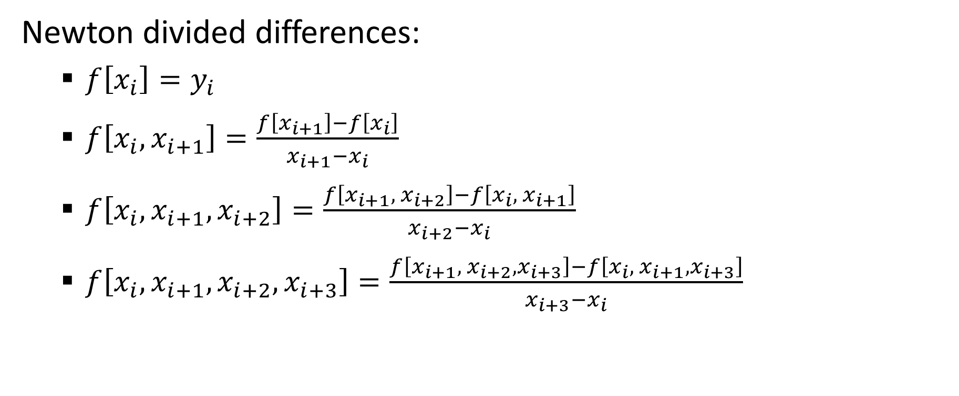
A systematic notation
Newton divided differences:
$f\left[x_{i}\right]=y_{i}$
$f\left[x_{i},x_{i+1}\right]=\frac{f\left[x_{i+1}\right]−f\left[x_{i}\right]}{x_{i+1}−x_{i}}$
$f\left[x_{i},x_{i+1},x_{i+2}\right]=\frac{f\left[x_{i+1}, { x}_{i+2}\right]−f\left[x_{i},{ x}_{i+1}\right]}{x_{i+2}−x_{i}}$
$f\left[x_{i},x_{i+1},x_{i+2},x_{i+3}\right]=\frac{f\left[x_{i+1}, { x}_{i+2},x_{i+3}\right]−f\left[x_{i},{ x}_{i+1},x_{i+3}\right]}{x_{i+3}−x_{i}}$
Notes:
There is a general formula for the model parameter bi in the Newton interpolation.
To write this formula in a compact way one likes to introduce some notations, the so called Newton divided differences
Newton divided differences are defined in levels.
The first level is defined as $f\left[x_{i}\right]=y_{i}$
The second level is
$$f\left[x_{i},x_{i+1}\right]=\frac{f\left[x_{i+1}\right]−f\left[x_{i}\right]}{x_{i+1}−x_{i}}$$
Note that it is defined based on the definition of $f\left[x_{i}\right]$
The third level is
$$f\left[x_{i},x_{i+1},x_{i+2}\right]=\frac{f\left[x_{i+1}, { x}_{i+2}\right]−f\left[x_{i},{ x}_{i+1}\right]}{x_{i+2}−x_{i}}$$
And so on
Note how these expressions are built
Each level is made out of the difference of the preceding level in it’s numerator
The arguments of the Newton differences are always the last ones for the first Newton difference and the first ones for the second Newton difference
The denominator is the difference between the last and first argument of the Newton divided difference

Slide 7


A systematic notation
With these notations the Newton interpolating polynomial writes:
$$P_{m−1}(x)=$$
$$f\left[x_{1}\right]$$
$$+f\left[x_{1},x_{2}\right]\left(x−x_{1}\right)$$
$$+f\left[x_{1},x_{2},x_{3}\right]\left(x−x_{1}\right)\left(x−x_{2}\right)$$
$$+f\left[x_{1},x_{2},x_{3},x_{4}\right]\left(x−x_{1}\right)\left(x−x_{2}\right)\left(x−x_{3}\right)$$
$$+…$$
$$+f\left[x_{1},…,x_{m}\right]\left(x−x_{1}\right)…\left(x−x_{m−1}\right)$$
Notes:
With these notations one can write down the interpolating polynomial as displayed on the slide
As we are going to see in the coming example, it is in fact much simpler than you may think to compute these Newton divided differences

Slide 8

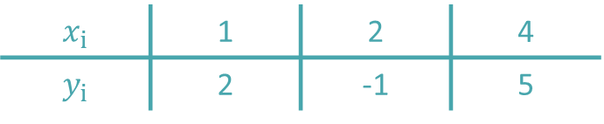
Example
Fit the following data points ($m=3$)
with a polynomial
$$P_{2}\left(x\right)=b_{0}+b_{1}\left(x−x_{1}\right){+b}_{2}\left(x−x_{1}\right)\left(x−x_{2}\right)$$
$$x_{i}$$ | 1 | 2 | 4
$$y_{i}$$ | 2 | -1 | 5
Notes:
In our example we want to interpolate three data points
Consequently we have a second degree interpolating polynomial
If we want to use Newton interpolation, the this interpolating polynomial writes as
$$P_{2}\left(x\right)=b_{0}+b_{1}\left(x−x_{1}\right){+b}_{2}\left(x−x_{1}\right)\left(x−x_{2}\right)$$

Slide 9


Example
We organize our calculations in a table
1 | 2
2 | -1
4 | 5
$$x_{i}$$
$$y_{i}$$
Notes:
We organize our calculations in a table
In the first column we write down the x values of the data points and in the second column we write down the y values
The second column is the first level of the Newton divided differences

Slide 10

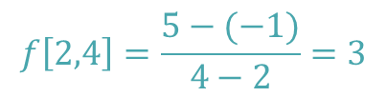
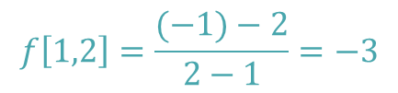
Example
Second level of Newton’s divided differences
$$f\left[1,2\right]=\frac{(−1)−2}{2−1}=−3$$
1 | 2
 |  | -3
2 | -1
 |  | 3
4 | 5
$$f\left[2,4\right]=\frac{5−(−1)}{4−2}=3$$
$$f\left[x_{i},x_{i+1}\right]$$
Notes:
Then we build the second level of Newton’s differences
For this we compute the difference of the previous level divided by the corresponding x values
For example to get the Newton divided difference between the x values 1 and 2 we proceed as follows:
First draw lines as shown, Then consider the highlighted boxes.
Take the difference between -1 and 2.
Then divided by the difference between 2 and 1
Same way we get the Newton difference between x values 2 and 4
Draw the lines as shown and then consider the numbers in the highlighted boxes
f[2,4] is then given by calculating the difference between 5 and -1 divided by the difference between 4 and 2

Slide 11

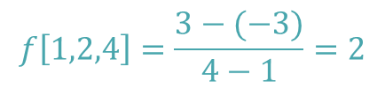
Example
Third level Newton’s divided differences
1 | 2
 |  | -3
2 | -1 |  | 2
 |  | 3
4 | 5
$$f\left[1,2,4\right]=\frac{3−(−3)}{4−1}=2$$
$$f\left[x_{i},x_{i+1},x_{i+2}\right]$$
Notes:
The third level of the Newton divided differences are obtained exactly with the same mechanism
First draw the highlighted lines
They point to the previous level of Newton’s divided differences that have to be used for the calculation
The x values, that will be used in the denominator, are found by following further the lines
Then f[1,2,4] is given by the difference between 3 and -3 divided by the difference between 4 and 1

Slide 12



Example
Newton interpolation polynomial
1 | 2
 |  | -3
2 | -1 |  | 2
 |  | 3
4 | 5
$$P_{2}(x)=2−3\left(x−1\right)+2\left(x−1\right)\left(x−4\right)$$
$$f\left[x_{1} \right]$$
$$f\left[x_{1},x_{2},x_{3}\right]$$
$$f\left[x_{1},x_{2}\right]$$
Notes:
We have now computed all needed Newton divided differences
Remains to write down the interpolating polynomial
The first model parameter bo is f[x1] which is found at the top of the second column
The second model parameter b1 is f[x1,x2] which is found at the top of the third column
And the third model parameter b2 is f[x1,x2,x3] which is found at the top of the forth column
As an exercise I invite you to verify that the found interpolating polynomial indeed passes by all data points.
Recall that the data points are listed in the first two columns of our table

Slide 13
Example
$$P_{2}(x)=2−3\left(x−1\right)+2\left(x−1\right)\left(x−4\right)$$
$$y$$
$$x$$
Notes:
Plotting the data points and the interpolating polynomial confirms that it indeed passes by all data points.

Slide 14
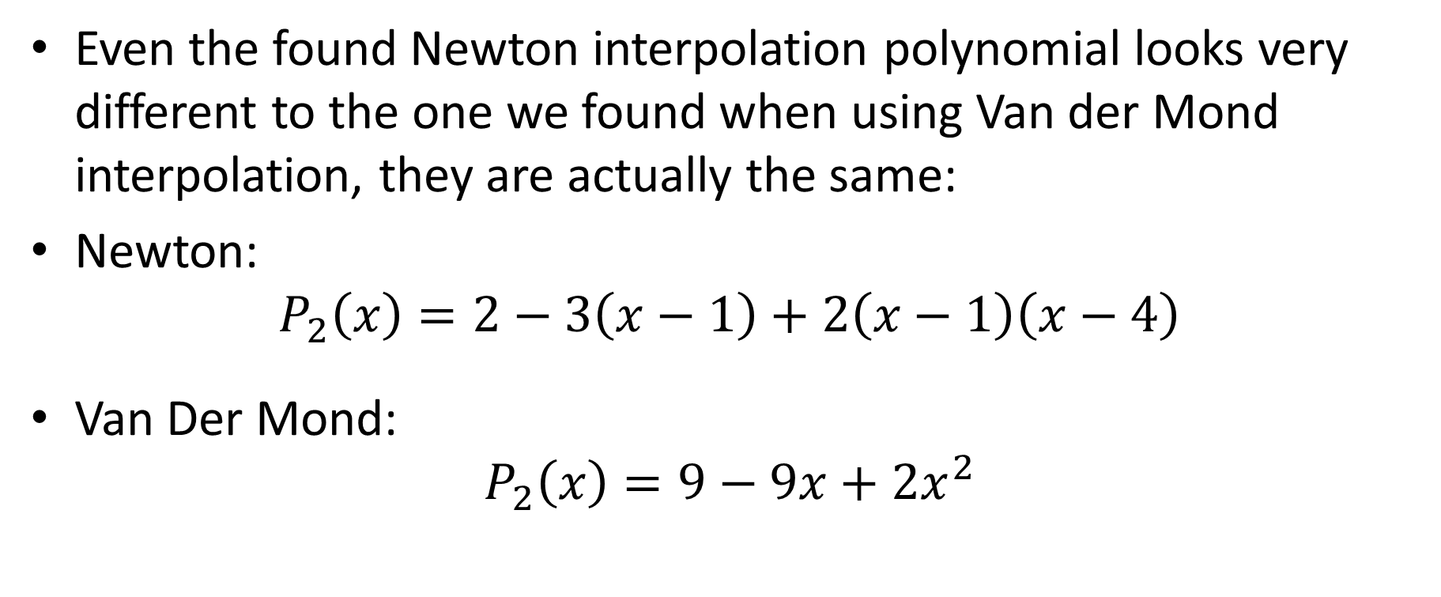
Example
Even the found Newton interpolation polynomial looks very different to the one we found when using Van der Mond interpolation, they are actually the same:
Newton:
$$P_{2}\left(x\right)=2−3\left(x−1\right)+2\left(x−1\right)\left(x−4\right)$$
Van Der Mond:
$$P_{2}\left(x\right)=9−9x+2x^{2}$$
Notes:
Even the found Newton interpolation polynomial looks very different to the one we found when using Van der Mond interpolation, they are actually the same
With Newton interpolation we found the polynomial $2−3\left(x−1\right)+2\left(x−1\right)\left(x−4\right)$
With Van der Mond interpolation we found previously the polynomial $9−9x+2x^{2}$
I invite you to verify that indeed both polynomials are the same

Slide 15
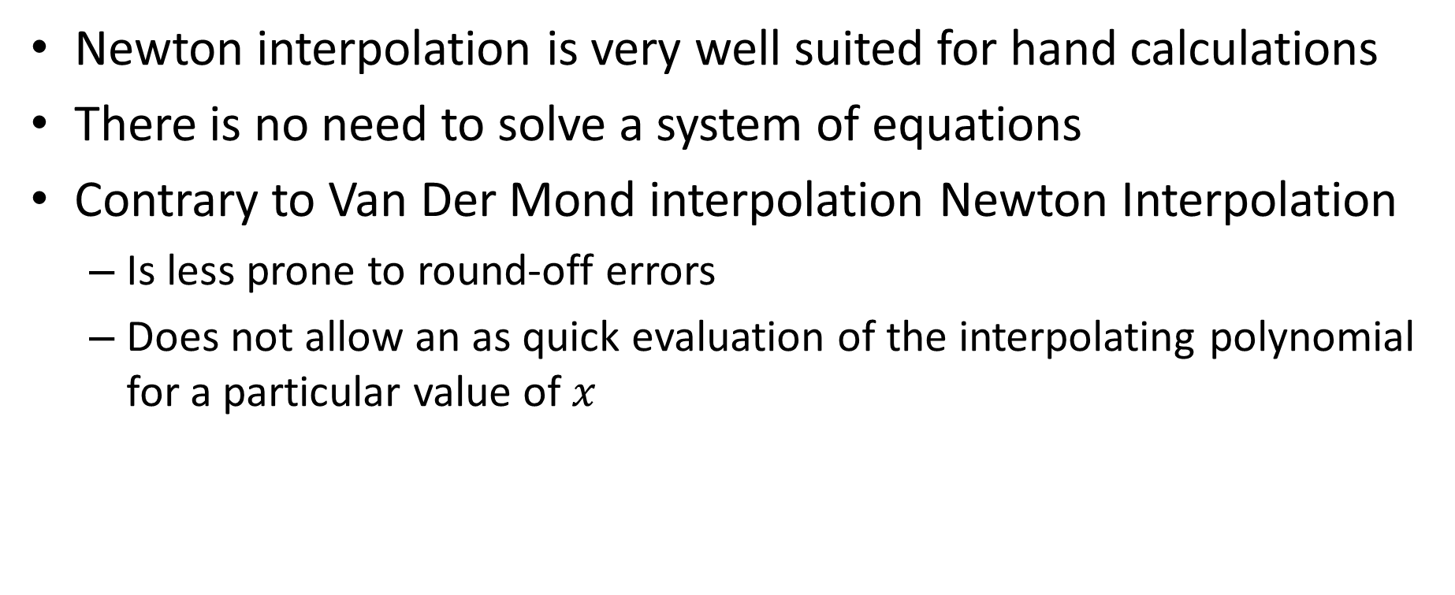
Some Remarks
Newton interpolation is very well suited for hand calculations
There is no need to solve a system of equations
Contrary to Van Der Mond interpolation Newton Interpolation
Is less prone to round-off errors
Does not allow an as quick evaluation of the interpolating polynomial for a particular value of $x$
Notes:
Let me add some remarks about Newton interpolation
Newton interpolation is very well suited for hand calculations
Indeed, there is no need to solve any equations
Compared to Van der Mond interpolation, Newton interpolation is less prone to round-off errors
But the Newton interpolating polynomial is not as fast to evaluate then the one we found with Van der Mond interpolation.

Slide 16
Summary
Newton interpolation allows the determination of an interpolating polynomial for a given data set
When organized in a table, the calculations are very efficient to be done by hand
Notes:
Let us summarize the key findings
Newton interpolation allows the determination of an interpolating polynomial for a given data set
When organized in a table, the calculations are very efficient to be done by hand

